Slide 1


Real Time Wireless Drone’s Payload for Sampling Images and IMU Data
Dan Blanaru
Supervision: Mr. Yehonatan Mandel
Autonomous Drones Lab
Faculty of Electrical Engineering
Tel Aviv University
December 2020
https://github.com/tau-adl/Drones-Navigation-Payload

Slide 2
Outline
Motivation
Project Goals
Approach
System Architecture
Design
Results
Other Project Products
Conclusion
Future Work
Acknowledgments

Slide 3
Motivation
Growing demand for small autonomous platforms to preform indoor navigation or non-GPS based navigation¹
Increasing interest in SLAM algorithms²
Lack of robust, flexible, generic, cheap and small form factor visual-inertial sensor³ for SLAM applications
1 https://bit.ly/3rGFPt9
2 https://yhoo.it/3ry0Bee
3 https://arxiv.org/pdf/1912.02469.pdf
Notes:
רפאל מציגה: רחפנים שטסים בתוך מבנה ומזהים אם האנשים בו חמושים
התעניינות מצד ענקיות טכנולוגיה (גוגל, מייקרוסופט...) עם גידול שוק משמעותי
מאמר שסוקר בנייה של מצלמה מסונכרנת למדיד IMU, עם סטאפ יחסית גדול ומסורבל

Slide 4
Project Goals
Creating visual-inertial sensor for drone’s payload that can send data wirelessly to a PC with low latency and real-time as possible
As implied from the goal above, the payload would be:
Small form-factor (and lightweight)
Minimal current consumption
Standard wireless transceiver - Wi-Fi, BT, 900MHz dongle, etc.
Data would be accurate to a 1msec timestamp precision
Camera frame acquisition – RGB\ Grayscale, ~20fps
IMU with 6DOF data
Communication with PC (Ubuntu\ Windows) and data integration with ROS framework

Slide 5
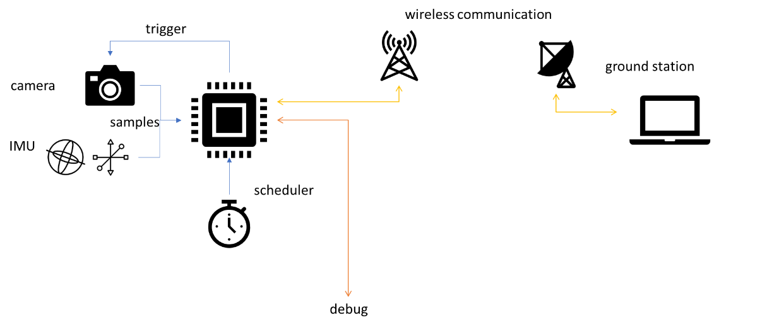
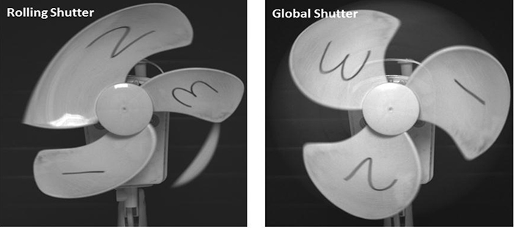
Approach
Understanding the main key components of our system
Market Survey
Camera – better implement a Global Shutter technology
Communication – Wi-Fi presents more advantages vs BT (bandwidth, interface)
IMU – includes 3-axis accelerometer and 3-axis gyroscope
CPU (MCU) – should include interfaces to all peripherals and work in real-time

Slide 6
System Architecture - Main Parts

Slide 7
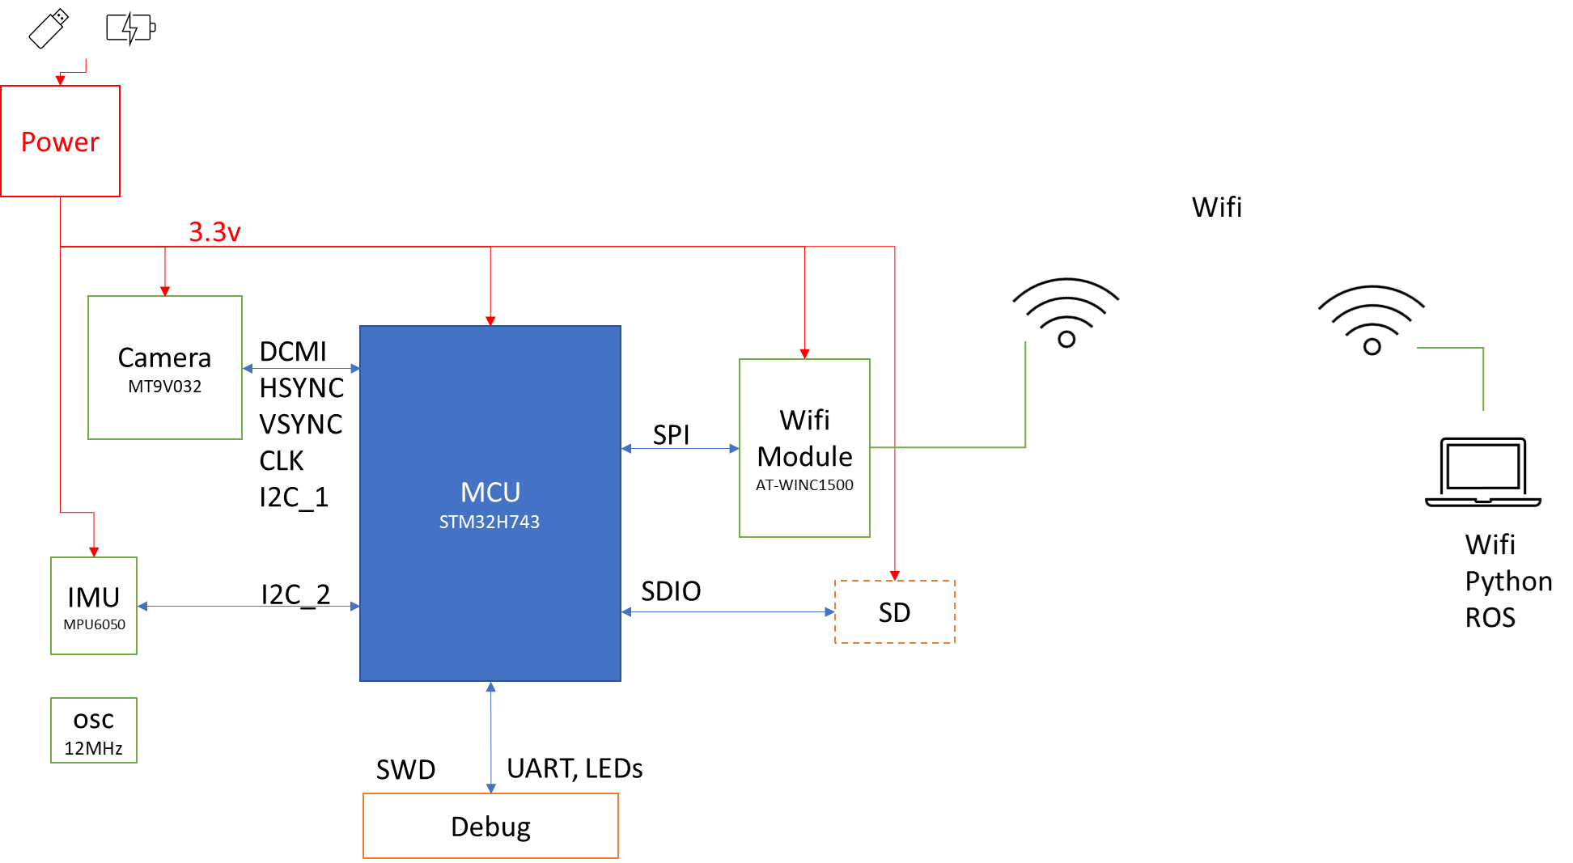
System Architecture

Slide 8
Design
Steps:
High-level design and product specifications
Using open-source schematics, creating BSP and configuring interfaces from MCU to each periphery
Utilizing drivers (both open-source and self-made) for each periphery
POC tests and benchmarks
Application utilization
Tests and benchmarks

Slide 9
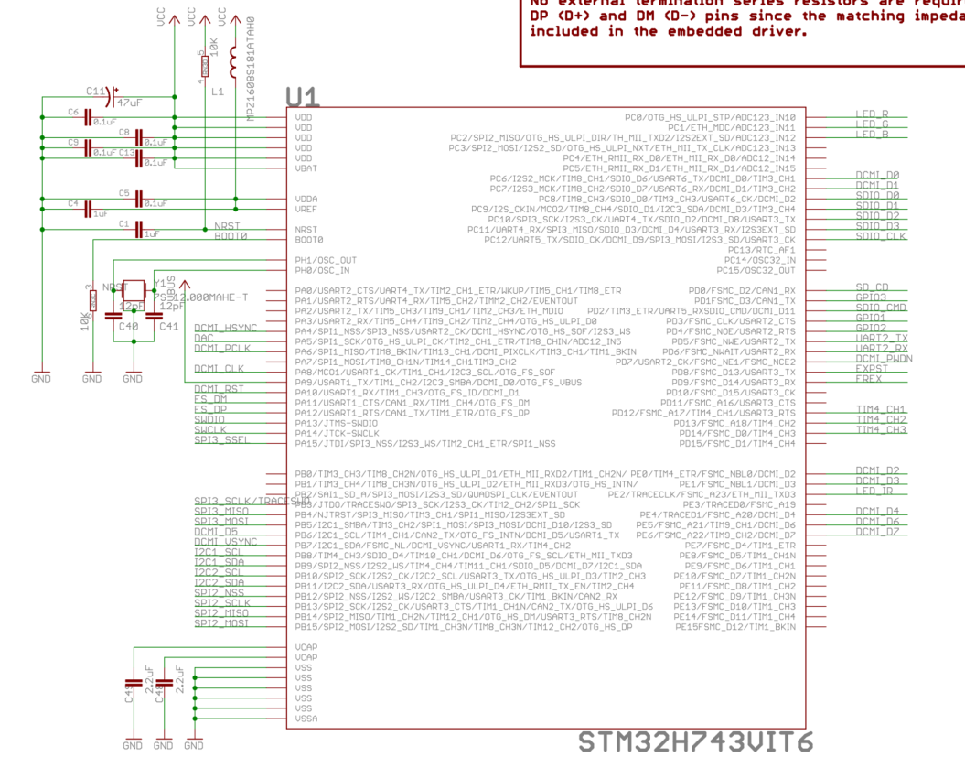
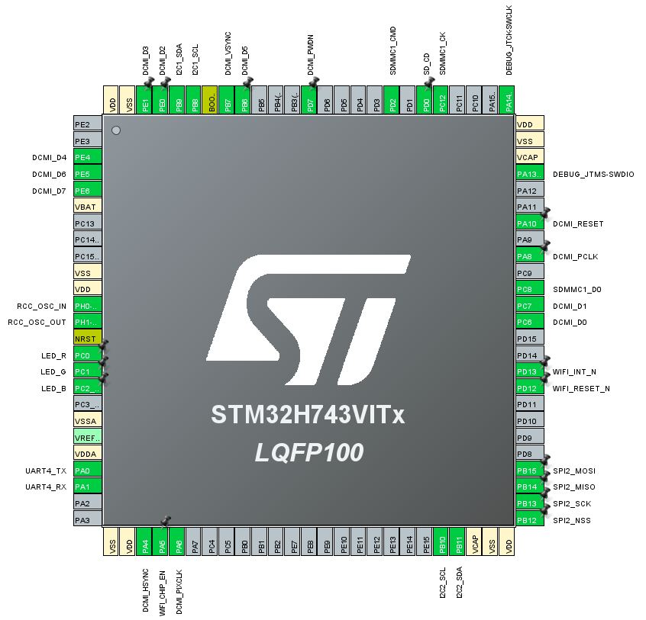
Design – BSP (Schematics to BSP)
1
1 https://openmv.io/

Slide 10
Design – Special MCU Internal Peripherals
DMA – Letting us transfer data efficiently between parts of the MCU
MPU – Manages transfer of data between different memory regions of the MCU
Timers – Creates system ‘heartbeat’ and synchronizes the different internal state machines and events
Communication interfaces – UART, I2C, SPI – for communicating between system parts
JPEG Encoder – Utilizing hardware periphery for compressing (and decompressing) JPEG images
DCMI – Dedicated Digital Camera Interface
SD – SD card + FATFS interface for saving images data locally

Slide 11
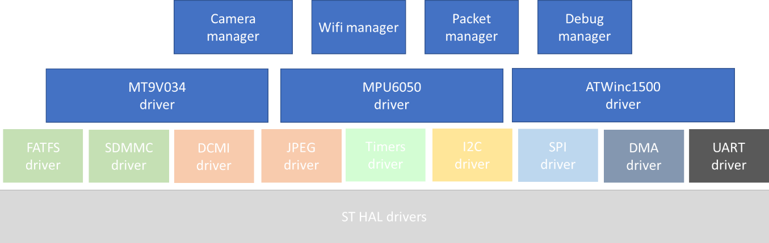
Design – Application Architecture

Slide 12
Design – Main Logic
Initialization
Initializes drivers and peripherals
Wait for Communication
Waits for ground station to request data
Main Loop
Acquire Image
Checks for peripheral health
Compress Image
Acquire IMU Samples
Send Data to Wi-Fi module

Slide 13
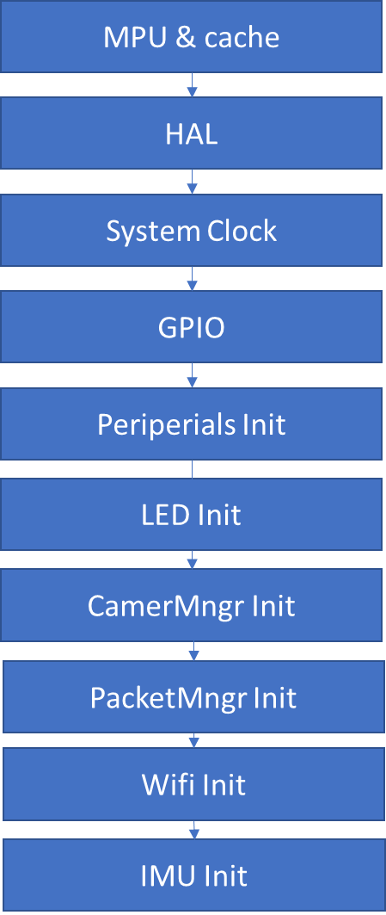
Design – Init Phase

Slide 14
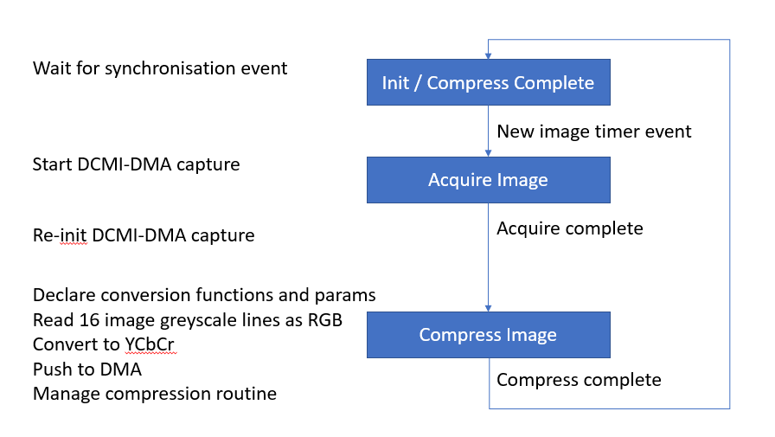
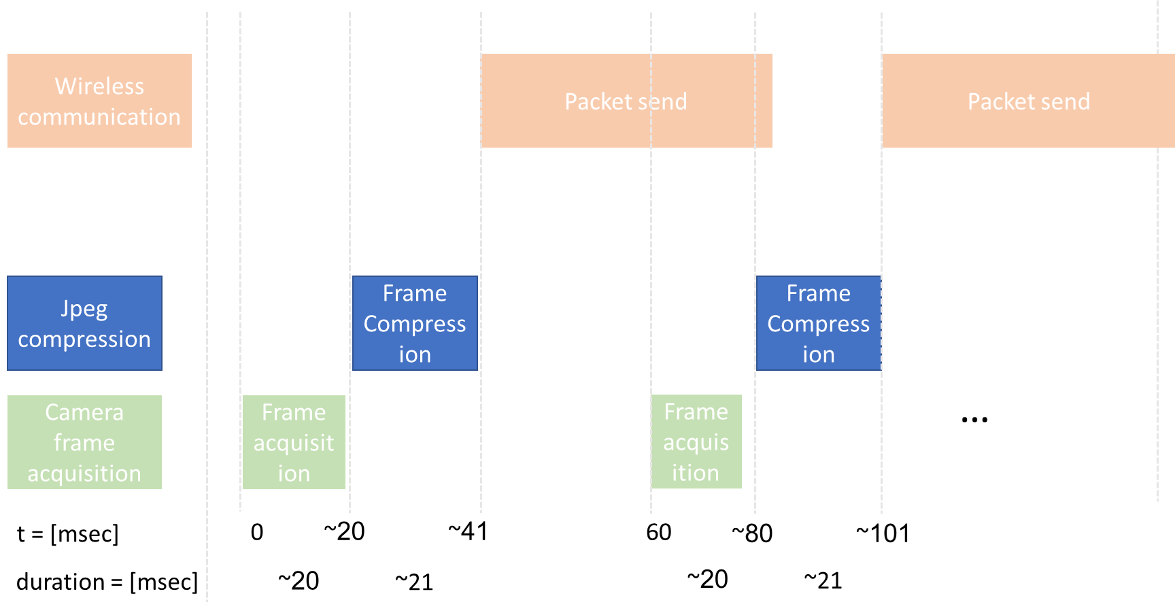
Design – Heartbeat and System Phases
Notes:
אירוע הטיימר מסנכרן את תחילת הצילום, לאחר מכן מיד מתחילה הדחיסה, והשליחה בעקבות סיום הדחיסה.
יש לדאוג לבניית תזמונים שלא גורמת לגלישה בפונקציונליות השליחה.

Slide 15
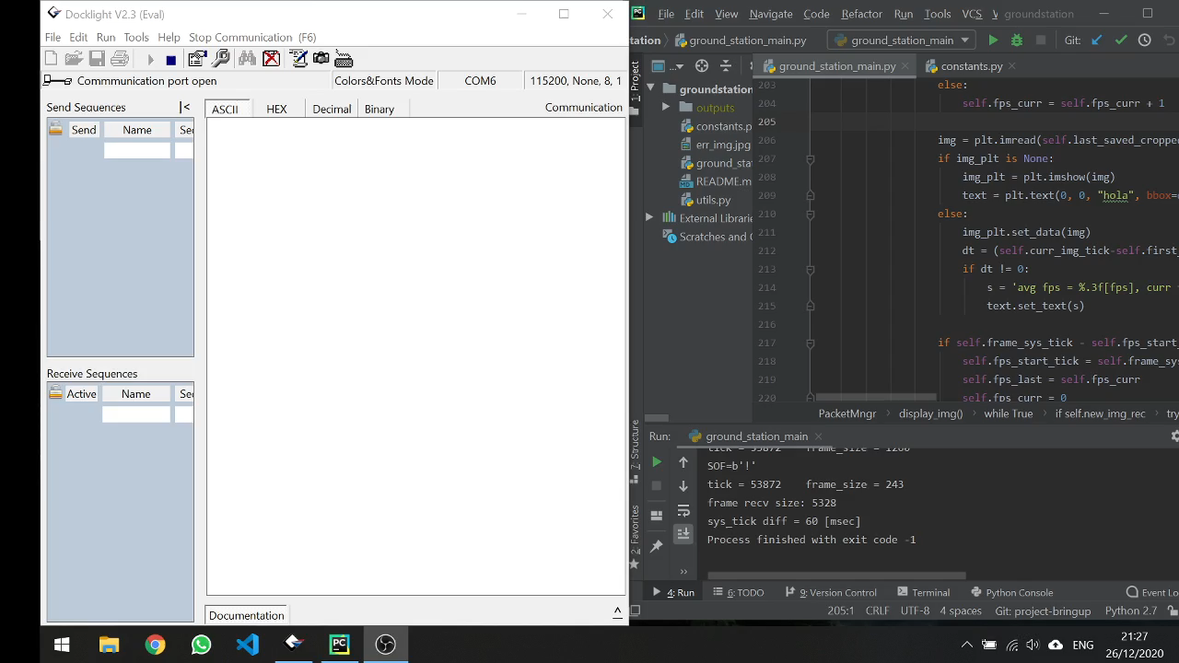
Results
Development setup demo

Slide 16
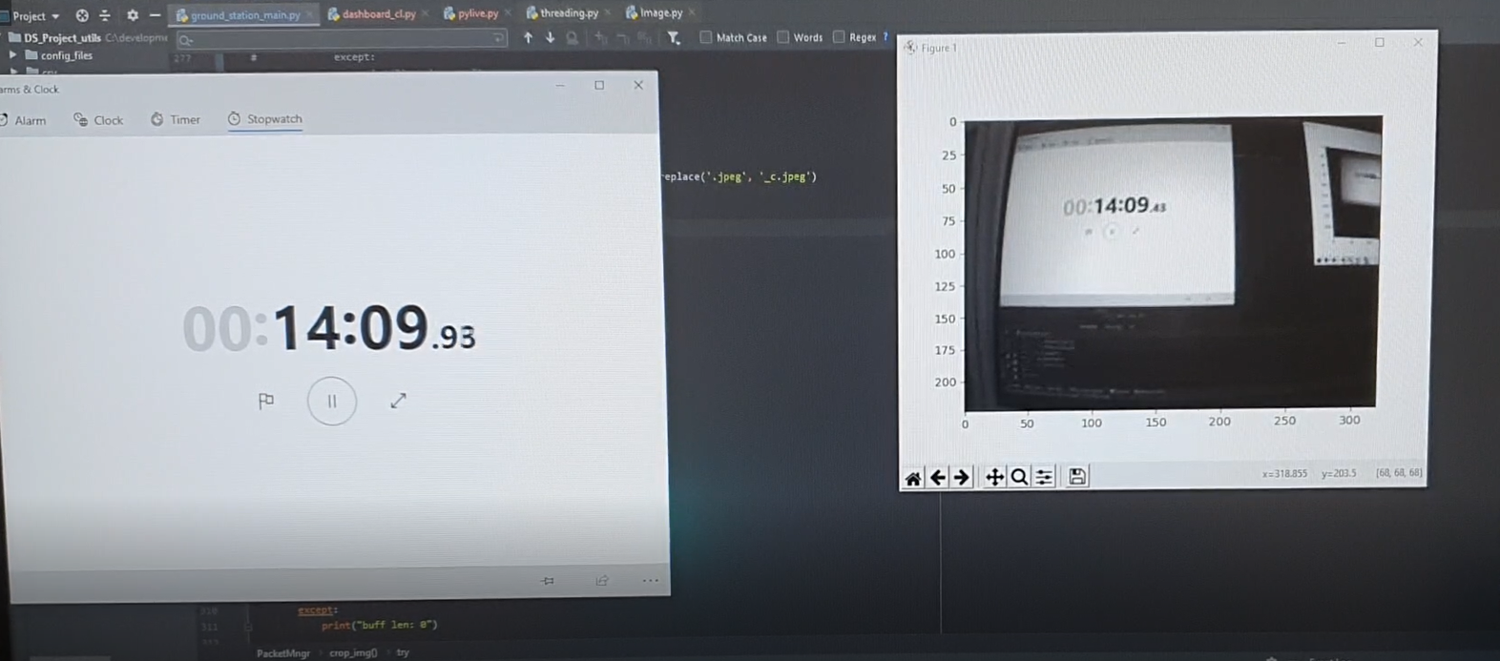
Results - Benchmark
Measurement setup
Typical FPS: 16fps
Resolution: 320x192, Grayscale
Results (our firmware) – ~10% better + sending IMU data
Results (existing OpenMV firmware example + chrome viewer):
delay
frames counted | average delay [msec] | stdev [msec] | max [msec] | min [msec]
16 | 237.50 | 27.73 | 270 | 200
delay
frames counted | average delay [msec] | stdev [msec] | max [msec] | min [msec]
16 | 266.25 | 32.19 | 360 | 230

Slide 17
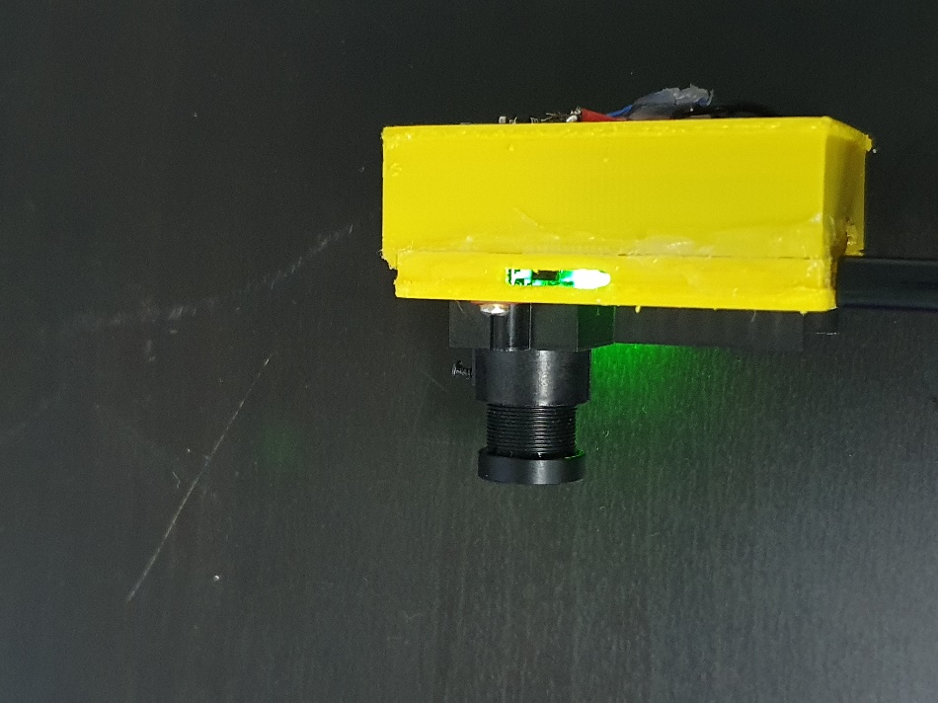
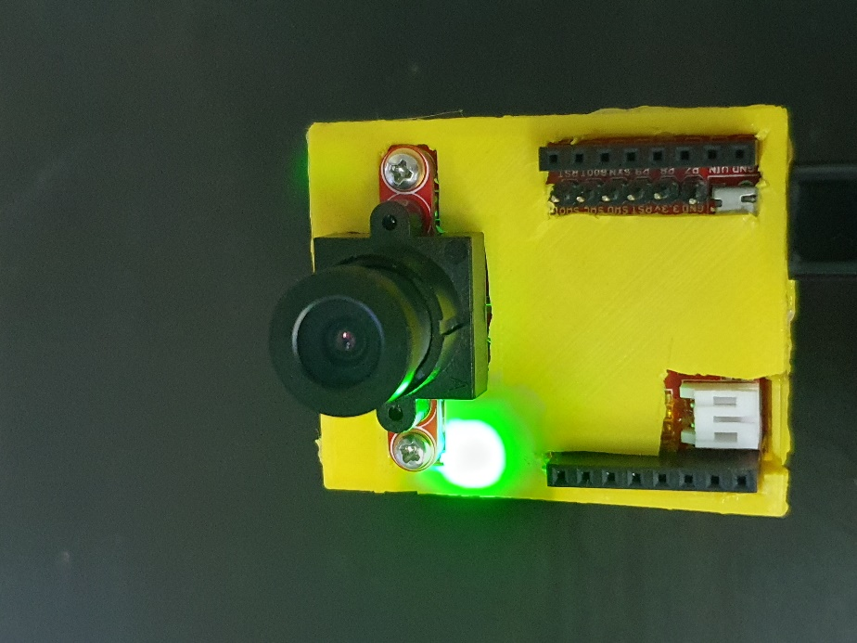
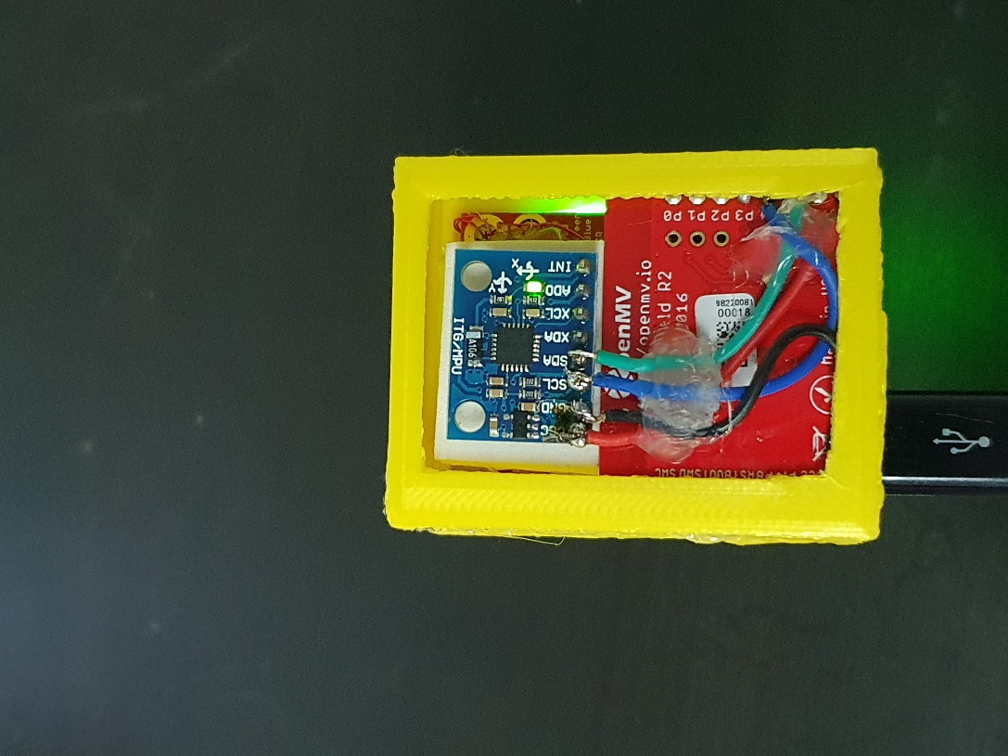
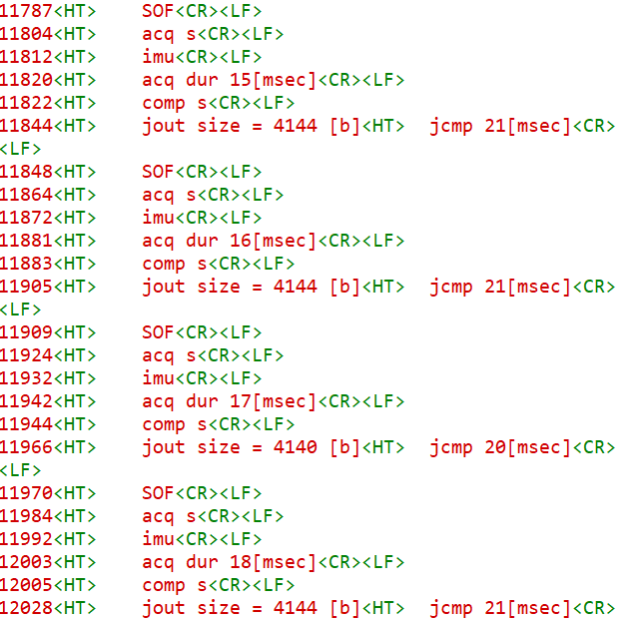
Other Project Products
A 3D printed casing was built¹, system packed, and parts soldered
Verbose debug interface made for benchmark: displays 1msec accurate timestamp + events
1 https://www.thingiverse.com/thing:1656029

Slide 18
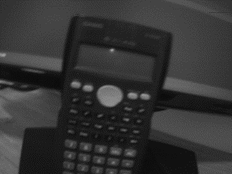

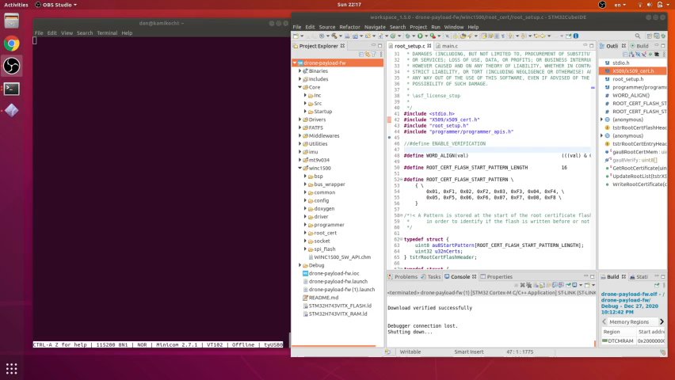
Other Project Products - Continued
Original
Ability to save input and output images of JPEG compressor – on SD card
Ubuntu eco-system burn & debug environment proof of concept for ADL’s purposes
Compressed

Slide 19
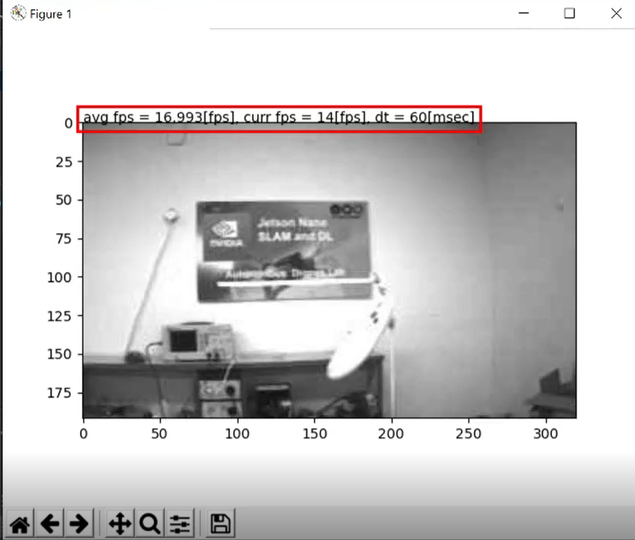
Other Project Products - Continued
Ground station live-view presentation of received image with benchmark

Slide 20
Discussion & Conclusions
Understanding that the Wi-Fi module has limited capabilities made the image compression necessary
Implementing debug capabilities is integral part of the system architecture – both HW and FW
Using of-the-shelf products leads to fast prototyping, but users might need the ability to customize the product

Slide 21
Future Work
Low-power modes for the system
Survey other transceivers for higher data rates - better resolution, less latency. Or varying the setup for current transceiver
Investigate the benefit for FLIR camera for the SLAM algorithms (the hardware supports it!)
Avoid fluorescent light flickering on camera
Utilizing USB debug interface
Dedicated system engineering – integrating all the parts on a single PCB, would lead smaller product, bring more robust HW

Slide 22
Acknowledgments
Thanks to Mr. Yehonatan Mandel for supervising and guiding throughout the process with
Moreover, I must acknowledge my partner for implementing and designing other parts of this project that was not mentioned here, and was mentioned in his work summery – thanks to Shenhav Ovadia for collaborating and building this system with me on this project

Slide 23
Thank You

